Slide 1
Better Credit Bureau - BCB
A BCDV1014 - DAPP2 capstone project presentation (a hyper ledger fabric approach to credit monitoring)
Shivam Rattan (GBC Blockchain development course - 2020-21 - Student id: 101339648)

Slide 2
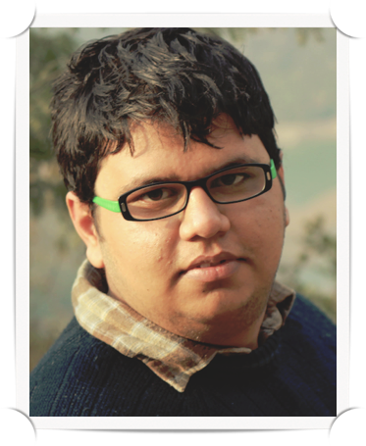
About Me
- 7 years of international multi-disciplinary experience in IT and Telecom
- Blockchain and Full Stack development from GBC
- Email: shivam.rattan@georgebrown.com
- LinkedIn: https://www.linkedin.com/in/shivamrattan/
- GitHub: https://github.com/shivamrulz

Slide 3
Current CreditCard monitoring System
- 3 major credit bureaus (Equifax, TransUnion and Experian)
- 3 major credit card companies (ViSA, MasterCard, American Express)
- 2 major flaws:
1. Isolated: Even within a country the bureaus don’t share, international sharing is farfetched.
2. Costly: $20 per month for monitoring credit score per bureau: totalling to $500 per year.

Slide 4
Story time: There once was a an immigrant name Shivam who applied for a Canadian credit card.
Question: How many months did it take Shivam to get his first Canadian Credit card?

Slide 5
Answer: 3 months
- First for applying and waiting on the results (thanks to Covid)
- Second for discovering an issue with the credit report, and mailing TransUnion supporting information to fix adverse credit report
- Third for reapplying with ‘corrected’ information

Slide 6
What Exists…

Slide 7
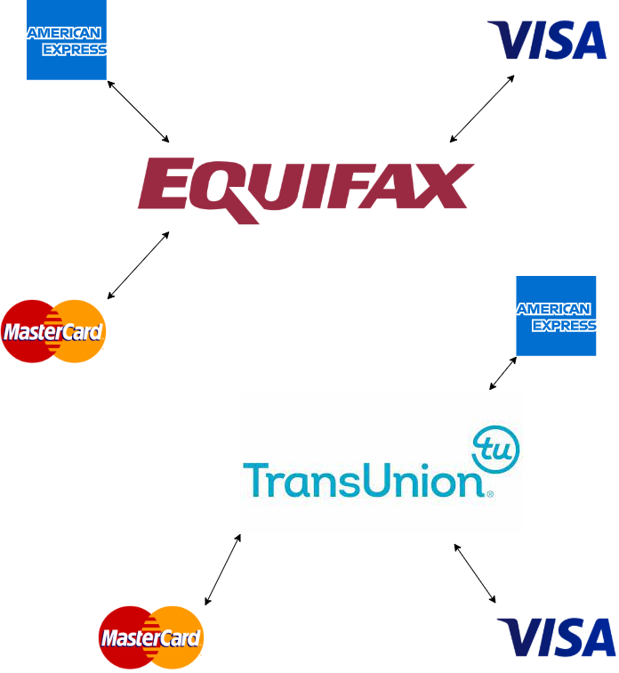
…Canada has only 2 bureaus, other countries have 3, imagine the disconnected world we live in

Slide 8
What should Exist!

Slide 9
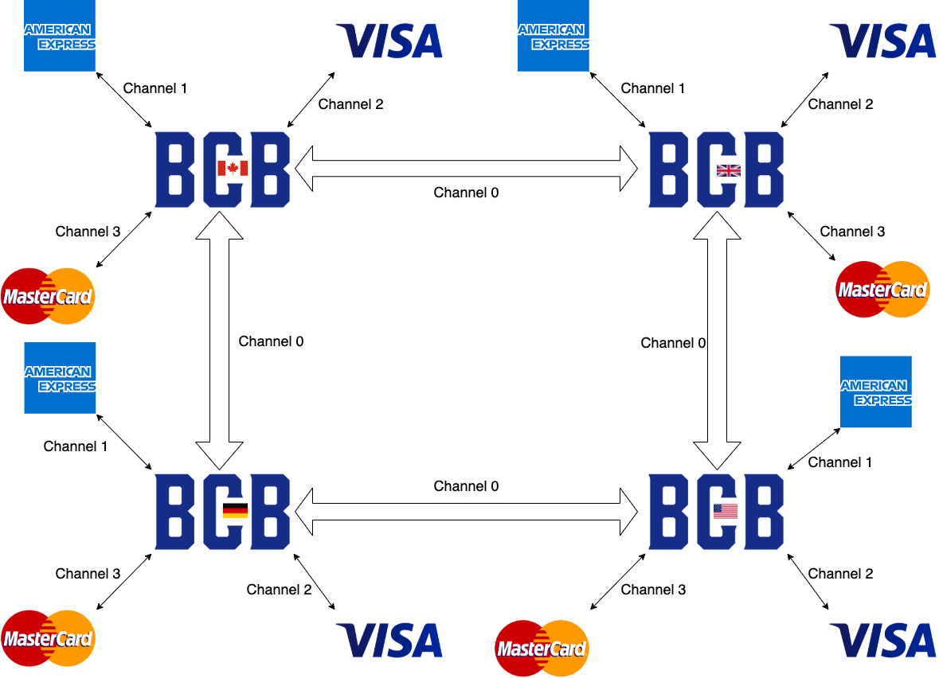

Slide 10
BCB (Better Credit Bureau) - A Hyperledger fabric approach to credit monitoring
- Globally 5,000 CC transactions happen per second; HLF blockchain supports up to 13,000
- Private Permissioned nature of HLF provides RBAC, immutability, and security, while not compromising on speed
- 1 BCB account per earthling

Slide 11
Key Benefits
- Credit history gets internationally synchronised
- Prevents frauds
- Global standardisation accelerates credit adoption in emerging markets

Slide 12
Market Opportunity
- Equifax and TU charge $20 monthly fee. Every Canadian checks their credit score at least once an year. 25,000,000 Canadians over 17 imply a $5 billion revenue.
- The Hyperledger fabric technology’s flexibility allows for global scalability, open to earn trillions of $.
- The technology can be acquired by competition and integrated within their platform, potentially for millions of dollars.

Slide 13
Mockups

Slide 14
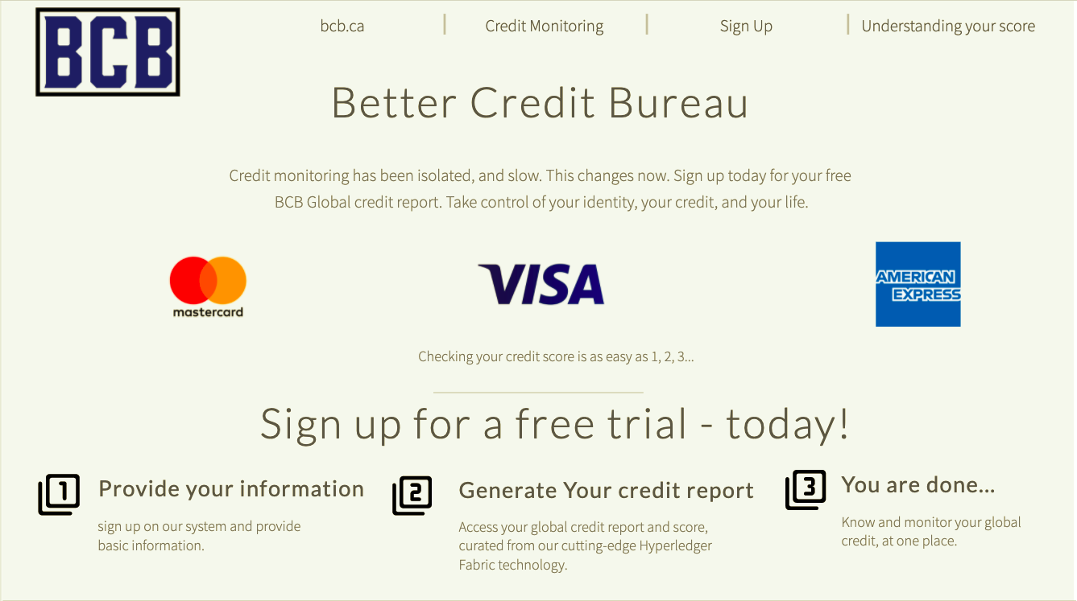

Slide 15
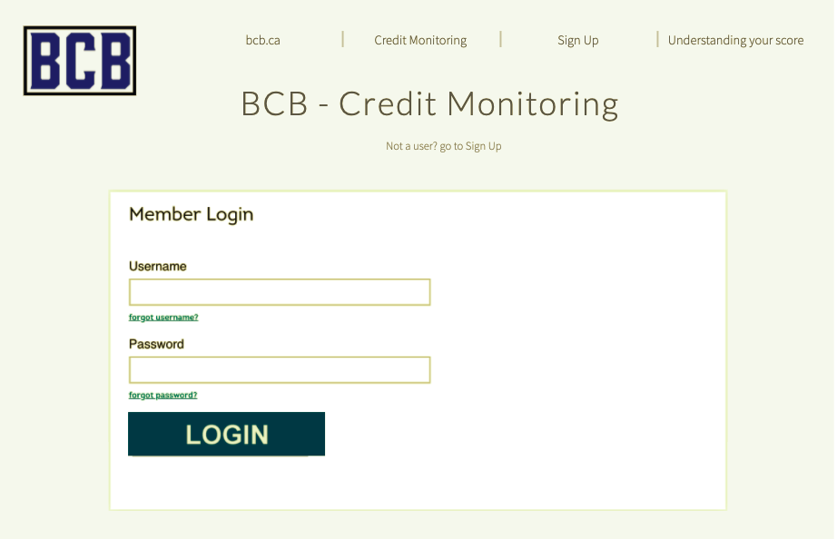

Slide 16
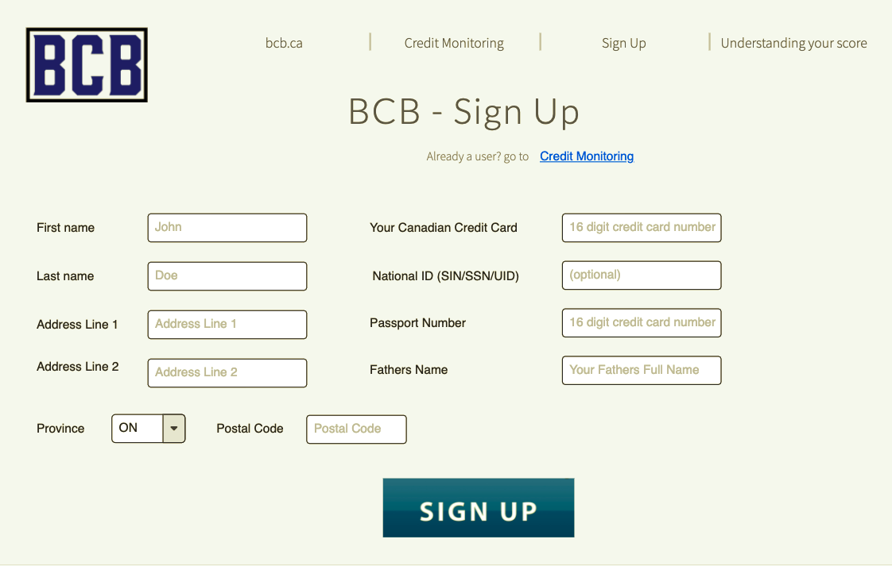

Slide 17
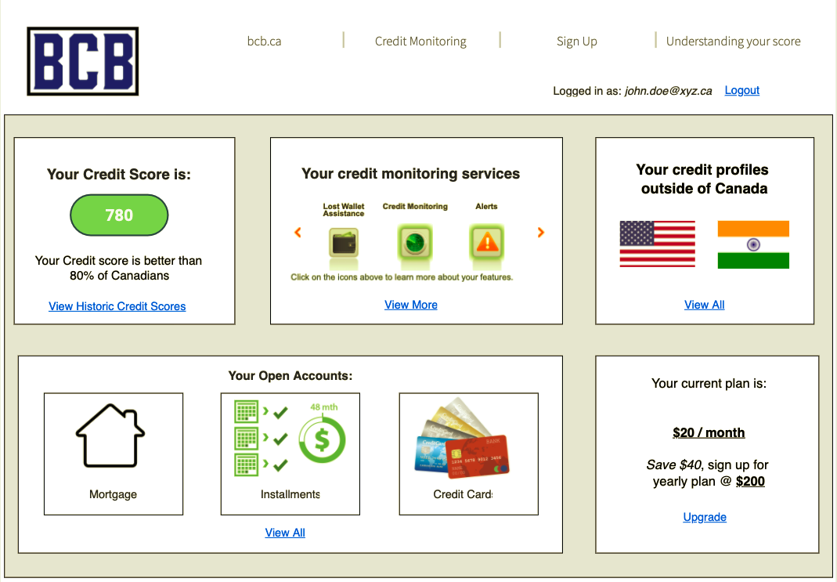

Slide 18
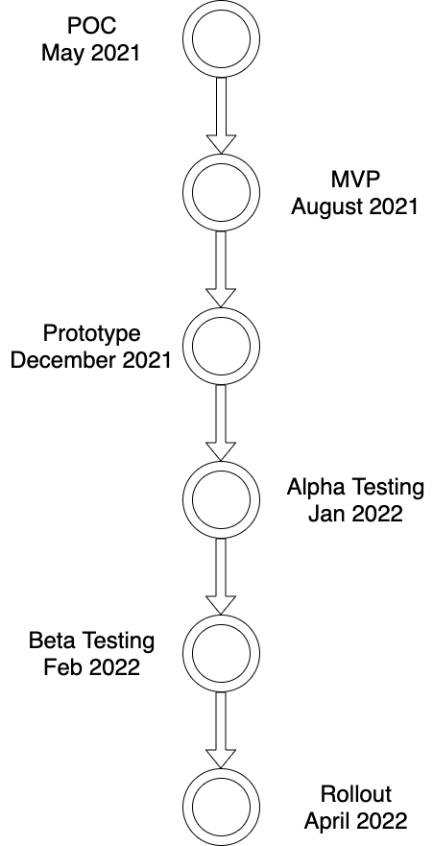
Timeline

Slide 19
Let bring the world closer by going F.A.R
- Fund: $2 million for a 10% equity to aid development.
- Adopt: Adoption by local governments in various countries
- Report: Ask your cc provider to report your usage to BCB
- Enable: World be a much more connected place
Questions? Reach out to shivam.rattan@georgebrown.ca

